Slide 1
Connecting Devices

Slide 2

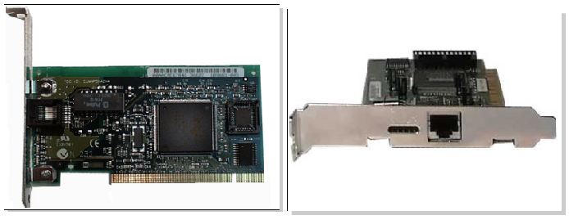

Slide 3

The Network Interface Card links the computer to the Computer Network.
It serves as the input /output device transferring data in and out of the computer.
The function of a NIC is to connect a host device to the network medium. NICs are considered Layer 2 devices because each NIC carries a unique code called a MAC address (48 Bit address) .

Slide 4

Repeaters and hubs are Physical Layer devices (Layer 1 device)
These devices are simple,
They transmit bits, but do not evaluate them
They add power to the signal as they actively retransmit it.
Repeaters operate on bits and extend the length of a physical medium.

Slide 5
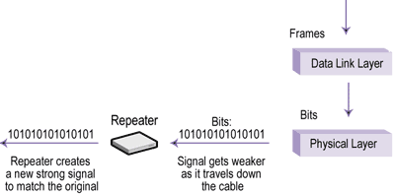

Slide 6

To increase the number of devices connected to a network, we use a device called a "hub".
Hubs provide a central point of connectivity for networking devices.
A hub is sometimes called a "wiring concentrator". or "multi-port repeaters"
Logically functions as a shared bus or multi-port repeater.
All devices connected to a hub receive frames transmitted by any other device on that hub.

Slide 7
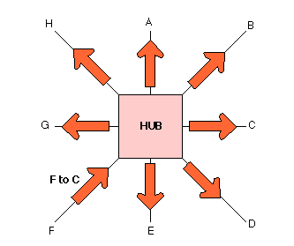

Slide 8

This connects two LANs that use same networks. Bridges operate at the Data Link Layer of the OSI model. Sometimes they are called "Layer 2 devices" or "Link Layer devices".
These devices are used to increase the overall performance of a network by isolating traffic within network segments.

Slide 9

Switches are Data Link Layer (Layer 2) devices used to increase performance in LANs
Like a bridge, a switch isolates traffic and creates separate collision domains by forwarding, filtering and flooding the frames.
Bridge, which shares the LAN bandwidth among all of its ports

Slide 10
Switch dedicates the entire LAN media bandwidth, such as 10-Mbps Ethernet, to each port-to-port frame transmission.
That is a switch multiplies the bandwidth between each port
Like bridge , hub is also shared(divide) the bandwidth between each ports

Slide 11
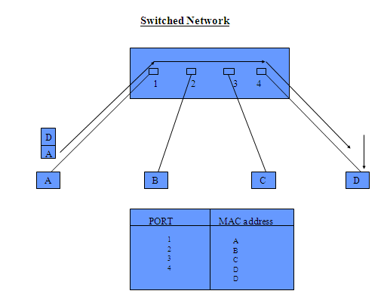

Slide 12

Router connects multiple networks. It is a internetworking device
A router operates at the Network Layer of the OSI reference model.
It makes intelligent packet-forwarding decisions based on each packet's network address (IP address / logical Address)

Slide 13
Routers use packet addresses (IP address) to route information between networks.
Each port of a router connects to a different network or subnet.

Slide 14
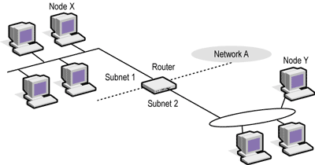

Slide 15

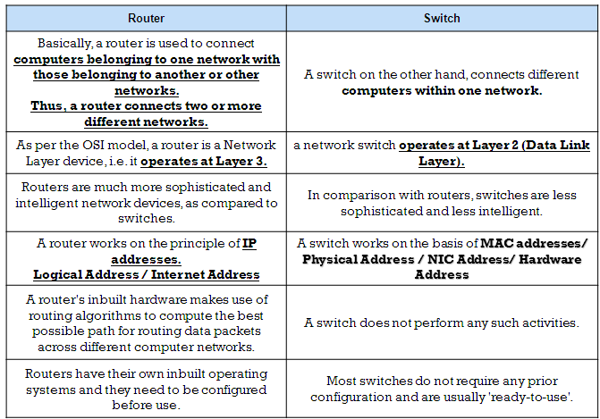

Slide 16

Transmission medium is the physical path between the transmitter and receiver.
It is the transmission medium through which information usually moves from one network device to another.
In some cases, a network will utilize only one type of cable, other networks will use a variety of cable types.
Module-I

Slide 17

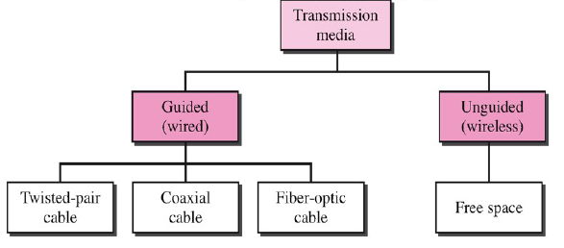
Module-I

Slide 18
Primary Cable Types
The networks are connected by some sort of wiring or cabling that acts as a network transmission medium that carries signals between computers.
Three major groups of cabling connect the majority of networks:
Coaxial cable
Twisted-pair (unshielded and shielded) cable
(UTP/STP)
Fiber-optic cable
Module-I

Slide 19
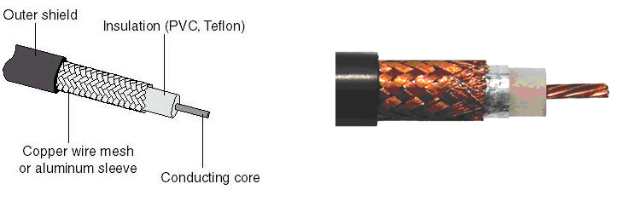
Coaxial Cable
In its simplest form, coaxial cable consists of a core of copper wire surrounded by insulation, a metal shielding, and an outer cover.
The core of a coaxial cable carries the electronic signals that make up the data.
This wire core is usually copper.
Surrounding the core is a dielectric insulating layer that separates it from the wire mesh.
The braided wire mesh acts as a ground and protects the core from electrical noise and crosstalk.
(Crosstalk is signal overflow from an adjacent wire.)
Module-I

Slide 20
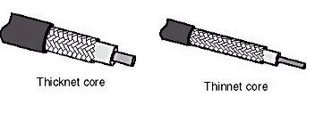
Types of Coaxial Cable
There are two types of coaxial cable:
Thinnet cable
Thicknet cable
Module-I

Slide 21
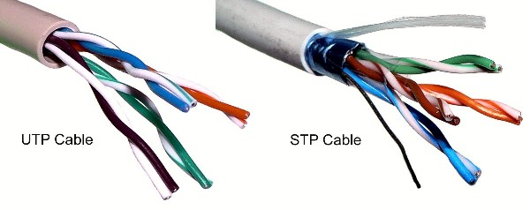
Twisted-Pair Cable
Twisted-pair cable consists of two insulated strands of copper wire twisted around each other.
Two types of twisted-pair cable: unshielded twisted-pair (UTP) and shielded twisted-pair (STP) cable.
A number of twisted-pair wires are often grouped together and enclosed in a protective sheath to form a cable. The twisting cancels out electrical noise from adjacent pairs and from other sources such as motors, relays, and transformers.
Module-I

Slide 22
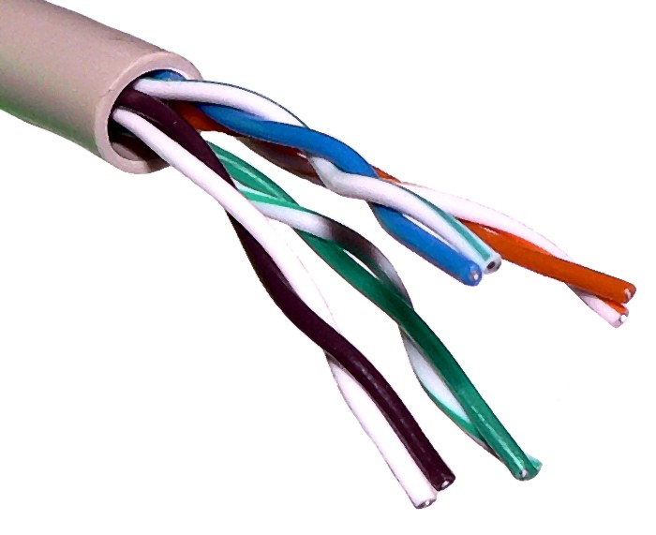
a) Unshielded Twisted-Pair (UTP) Cable
UTP, using the 10BaseT specification, is the most popular type of twisted-pair cable .
The maximum cable length segment is 100 meters. Traditional UTP cable consists of two insulated copper wires.
Module-I

Slide 23
Categories of UTP cable
Category 1 this can carry voice but not data transmissions
Category 2 UTP cable for data transmissions up to 4 Mbps
Category 3 UTP cable for data transmissions up to 16 Mbps
Category 4 UTP cable for data transmissions up to 20 Mbps
Category 5 UTP cable for data transmissions up to 100 Mbps
Category 6 UTP cable for data transmissions up to 155 Mbps
Category 7 UTP cable for data transmissions up to 1000 Mbps
Module-I

Slide 24
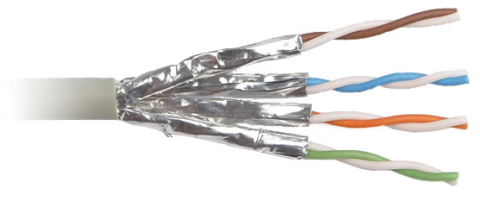
b) Shielded Twisted-Pair (STP) Cable
STP also uses a foil wrap around each of the wire pairs.
This gives STP excellent shielding to protect the transmitted data from outside interference, which allows higher transmission rates over longer distances than UTP.
Module-I

Slide 25
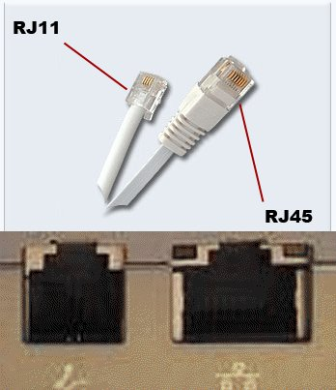
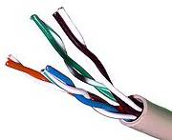
Hardware connection and UTP cable Termination
Two-pair (four-wire) UTP used for telephone use is normally terminated in an RJ-11 connector.
Four-pair (eight-wire) UTP used for data use is normally terminated in an RJ-45 connector
Module-I

Slide 26
Fiber-Optic Cable
In fiber-optic cable, optical fibers carry digital data signals in the form of modulated pulses of light.
This is a relatively safe way to send because fiber optic cable cannot be tapped, and its data cannot be stolen.
Fiber-optic cable is good for very high-speed, high-capacity data transmission because of the purity of the signal and lack of signal attenuation.
Module-I

Slide 27
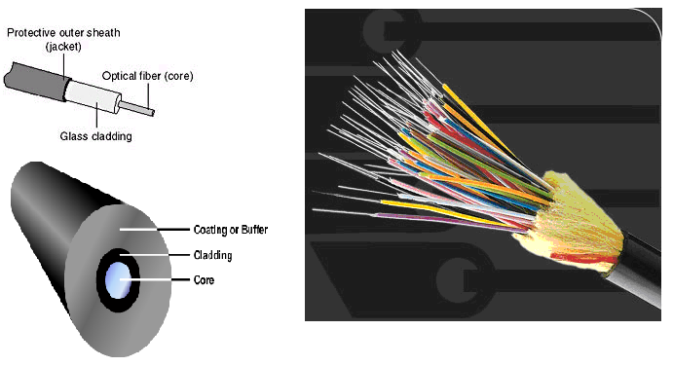
Types of Optical Fiber
Single-mode fiber
Multi-mode fiber
Module-I

Slide 28
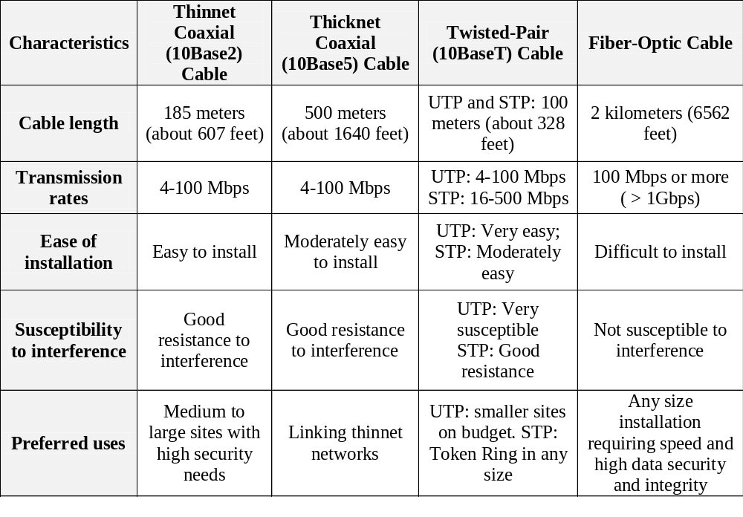
Cable Comparison Table
Module-I

Slide 29

Free space (Wireless) media carry electromagnetic signals at radio and microwave frequencies that represent the binary digits of data communications.
As a networking medium, wireless is not restricted to conductors or pathways, as are copper and fiber media.
Free space as the medium has the main advantage that the receiver can be fixed or mobile.
Free space is called an unguided medium because the electromagnetic waves can travel freely in all directions.
Module-I

Slide 30

Wireless transmission waves

Slide 31

Radio wave
Radio waves are used for multicast communications, such as radio and television, and paging systems. They can penetrate through walls. Highly regulated. Use omni directional antennas
Omnidirectional antenna

Slide 32

Microwaves
Microwaves are used for unicast communication such as cellular telephones, satellite networks and wireless LANs. Higher frequency ranges cannot penetrate walls. Use directional antennas - point to point line of sight communications.
Unidirectional antennas
7.<number>

